Slide 1



DEPARTMENT OF ELECTRONICS AND COMMUNICATION
MAJORPROJECT PRESENTATION ON (22ECP706)
AIRA: Autonomous Intelligent Robot Assistance
Submitted By
Ajay J G – 1DA22EC008
Karthik S R – 1DA22EC060
Maheshprabhu P – 1DA22EC073
Mohankumar S R – 1DA22EC082
Guide
Dr. Chethan S Assistant Professor, Dept. of ECE

Slide 2
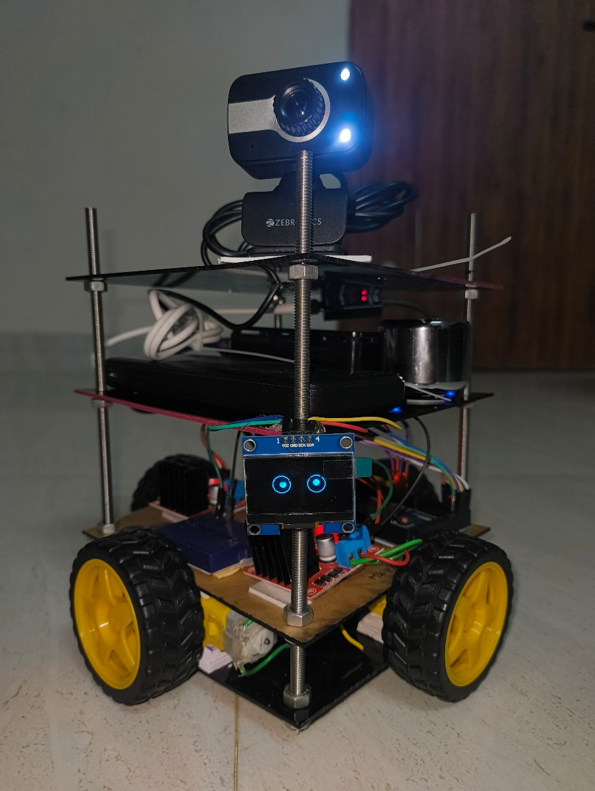
INTRODUCTION
AIRA (Autonomous Intelligent Robot Assistance) is a semi-autonomous personal assistant robot designed to enable natural and intuitive human–machine interaction through intelligent sensing, decision-making, and mobility. The system integrates embedded hardware and software intelligence to perform real-time navigation, obstacle avoidance, and user assistance tasks in indoor environments.
The robot is built using a Raspberry Pi as the high-level processing unit and an Arduino-based controller for real-time motor and sensor control. It employs DC geared motors for mobility, ultrasonic sensors for obstacle detection, a USB microphone and Bluetooth speaker for audio interaction, and a camera for future vision-based enhancements. A modular multi-layer acrylic chassis ensures mechanical stability and expandability.
AIRA serves as a practical proof-of-concept for intelligent assistive robotics, with applications in smart homes, education, elderly care, and research environments.

Slide 3
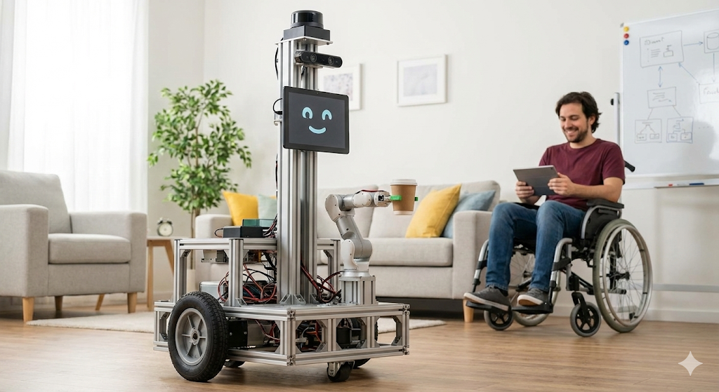
OBJECTIVES
To design and develop an autonomous intelligent robot capable of assisting users through real-time interaction and mobility.
To integrate embedded systems and artificial intelligence for sensing, decision-making, and task execution.
To implement safe indoor navigation with effective obstacle detection and avoidance.
To develop a modular and scalable hardware–software architecture for future enhancements.
To demonstrate a cost-effective robotic assistant suitable for smart homes, education, and assistive applications.

Slide 4
PROBLEM STATEMENT
Most existing voice assistants are limited to static devices such as smartphones and smart speakers, which can provide information but cannot perform physical actions in the real world. On the other hand, many robotic systems rely on manual controllers or mobile applications, making them less intuitive and inaccessible for certain users.
There is a need for an affordable and intelligent robotic system that combines natural human interaction with autonomous mobility. Such a system should be capable of understanding user commands, navigating safely in indoor environments, avoiding obstacles, and providing meaningful assistance without continuous human control.
The challenge is to design a modular, user-friendly robotic assistant that integrates embedded systems, sensors, and intelligent control to bridge the gap between conversational AI and physical robotic assistance.

Slide 5
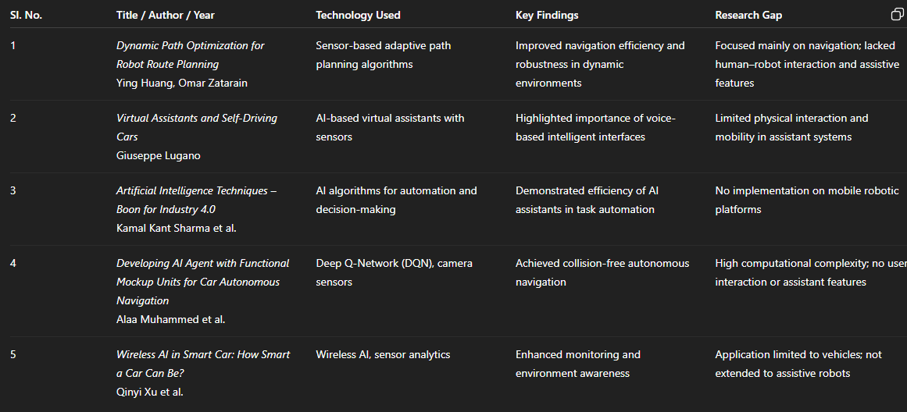
LITERATURE SURVEY

Slide 6
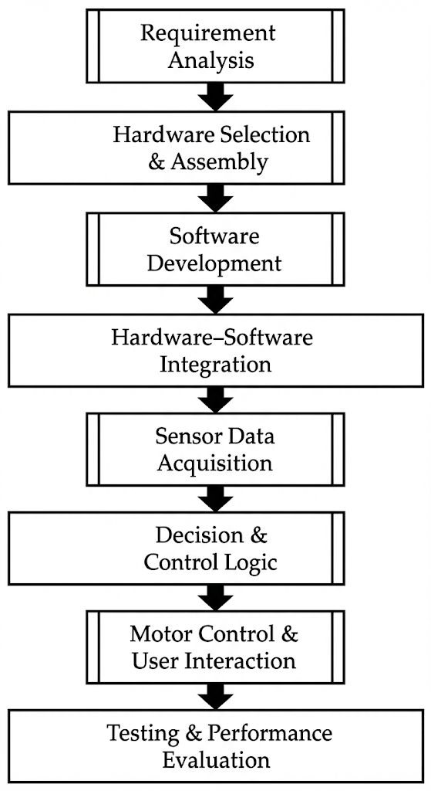
AIRA METHODOLOGY

Slide 7
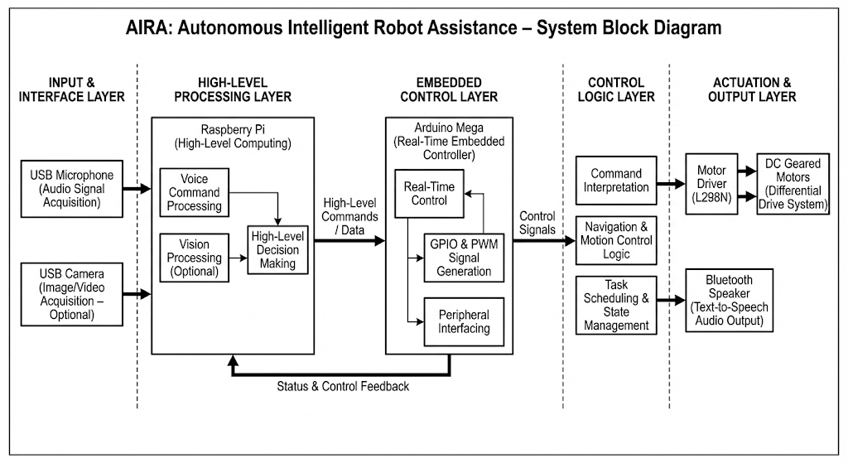

Slide 8
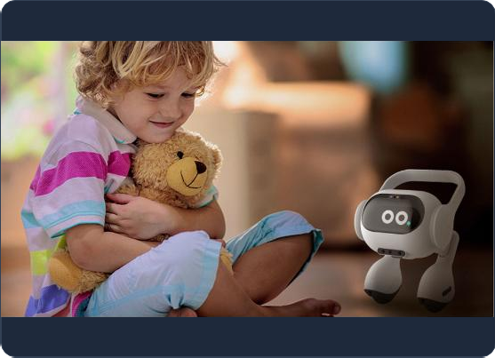
Redefining the Home Assistant
Shibu is a consumer-grade personal assistant designed to
bridge the gap between static smart speakers and autonomous agents.
AI-Powered: Runs local LLMs for intelligent reasoning.
Mobile: Fully autonomous movement, not tethered to a
wall.
Aware: Understands surroundings via vision and
Comminicative : Speaks and shows emotions.

Slide 9

The Inspiration
Democratizing Robotics
Inspired by advanced concepts like Samsung Ballie, Shibu
is designed to be accessible.
Open Architecture: Built on accessible hardware.
Modular Design: Easy to upgrade and repair.
Affordable: High-level AI at a fraction of the cost.

Slide 10








System Architecture
User Input
AI Host
Controller
Actuation
Voice & Visual
Commands via Mic & Webcam
Raspberry Pi 5
running Local LLMs
Arduino Mega
handling hardware logic
L298N Driver
powering 4 DC Motors

Slide 11
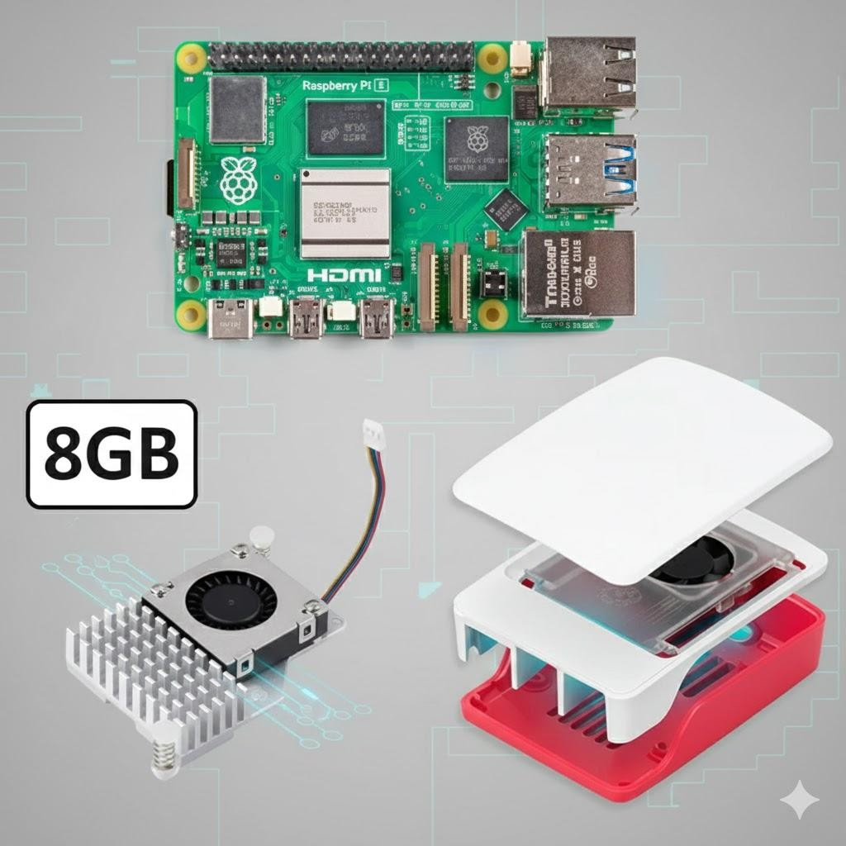

Under the Hood
Brain: Raspberry Pi 5 (8GB RAM) for AI.
Controller: Arduino Mega 2560.
Vision: Zebronics USB Webcam.
Face: 0.96" OLED Display.
Voice: Bluetooth Speaker + USB Mic.
Power: Li-ion Battery Pack.

Slide 12
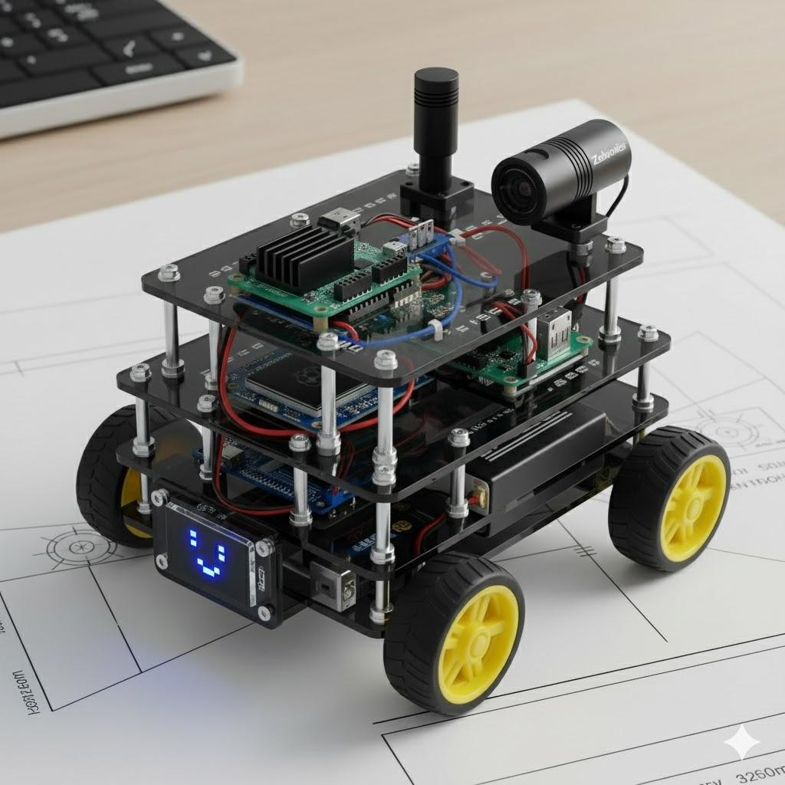
Mobility & Design
Engineered for Agility
Shibu features a lightweight chassis optimized for indoor environments.
The 4-wheel drive system provides superior traction on carpets and tiles, while the balanced weight distribution ensures stability during fast turns.

Slide 13

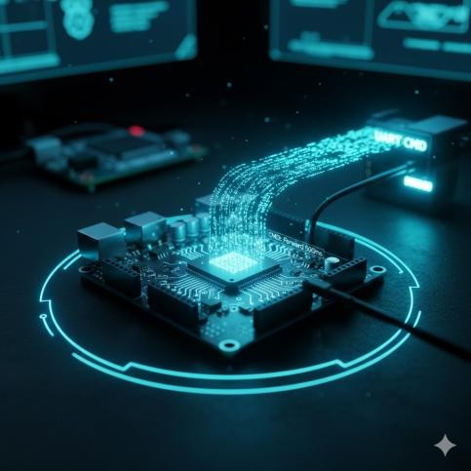
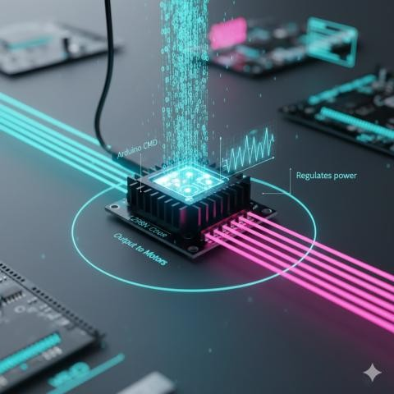
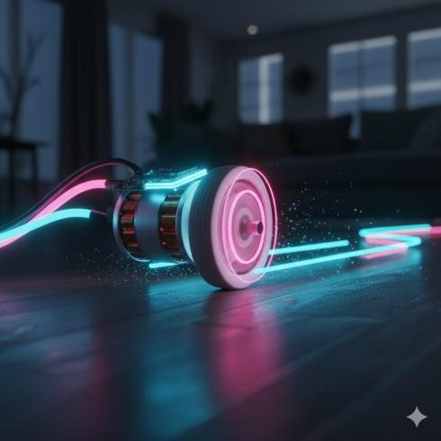
Precision Movement Flow
AI Engine
Arduino
L298N Driver
DC Motors
Decides movement
Receives UART cmd
Regulates power
Execute motion

Slide 14
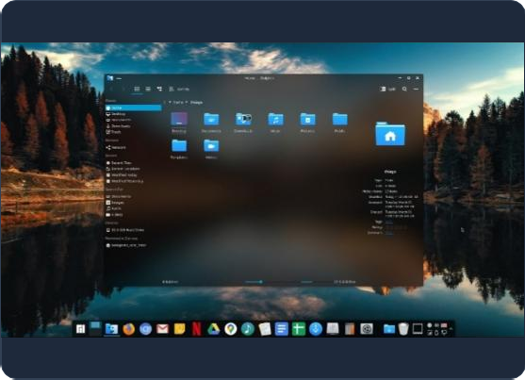
From Intent to Action
Command Translation
Shibu translates complex AI thoughts into physical movement codes.
1.
2.
3
.
Intent Parsing: AI identifies "Come here".
Lookup: Finds 'FORWARD' command.
Execution: Sends character code to Arduino.

Slide 15

The AI Brain
Powered by Raspberry Pi 5
Shibu processes intelligence locally, ensuring speed and privacy without relying on cloud servers for basic thinking.
This approach guarantees low latency for voice triggers and keeps your personal data secure on the device.

Slide 16

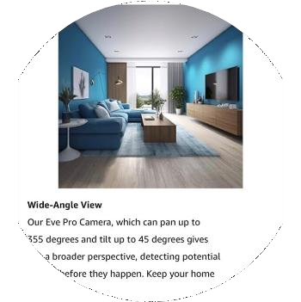
Computer Vision
Seeing the World
Shibu utilizes a Zebronics HD Webcam to perceive its environment.
Live Streaming: Remote view of what Shibu sees.
Snapshots: "Shibu, take a picture."
Future-Ready: Capable of object recognition upgrades.

Slide 17
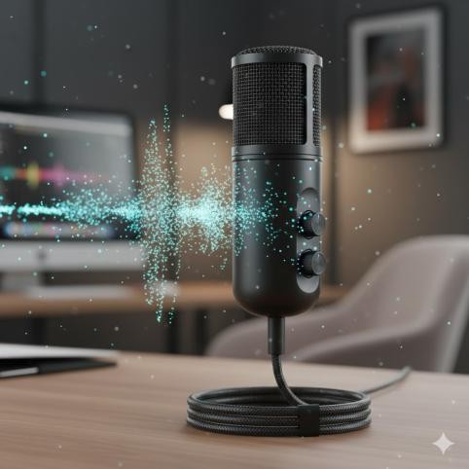


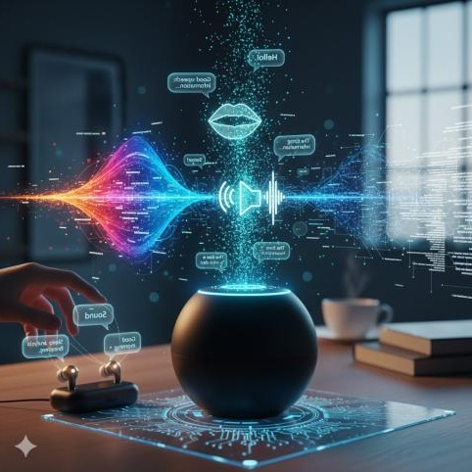
Audio Pipeline
Mic Input
Whisper AI
LLM Core
Speaker
Capture Audio
Transcribe
Reasoning
TTS Output

Slide 18
The Cognitive Stack
High-Level Reasoning
LLaMA / Mistral
Used for complex conversation, context understanding, and general knowledge queries.
Fast Response
TinyDolphin / Gemma
Lightweight models optimized for specific command detection and quick, casual chat interactions.

Slide 19
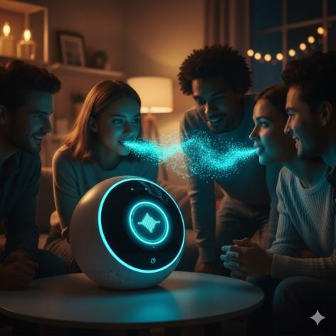
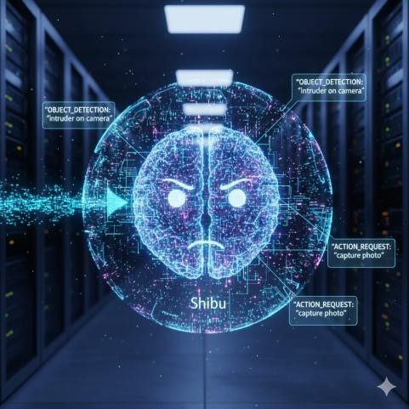
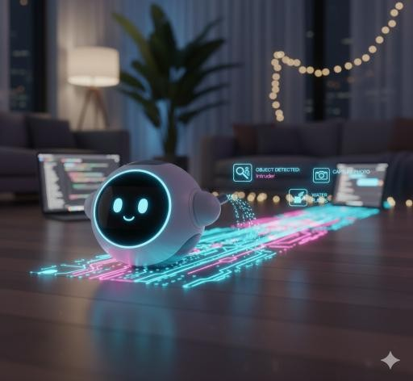
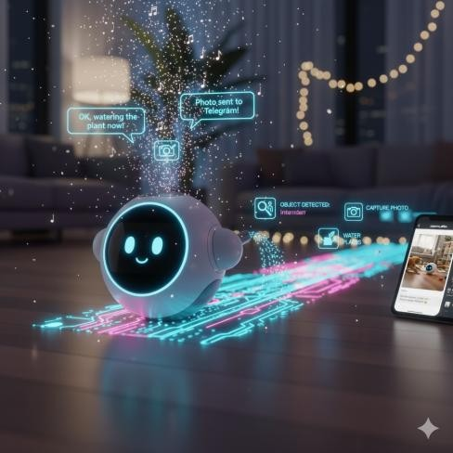
Interaction Flow
Voice
Intent
Action
Response
User speaks
Analysis
Motor/Display
Audio/Visual

Slide 20
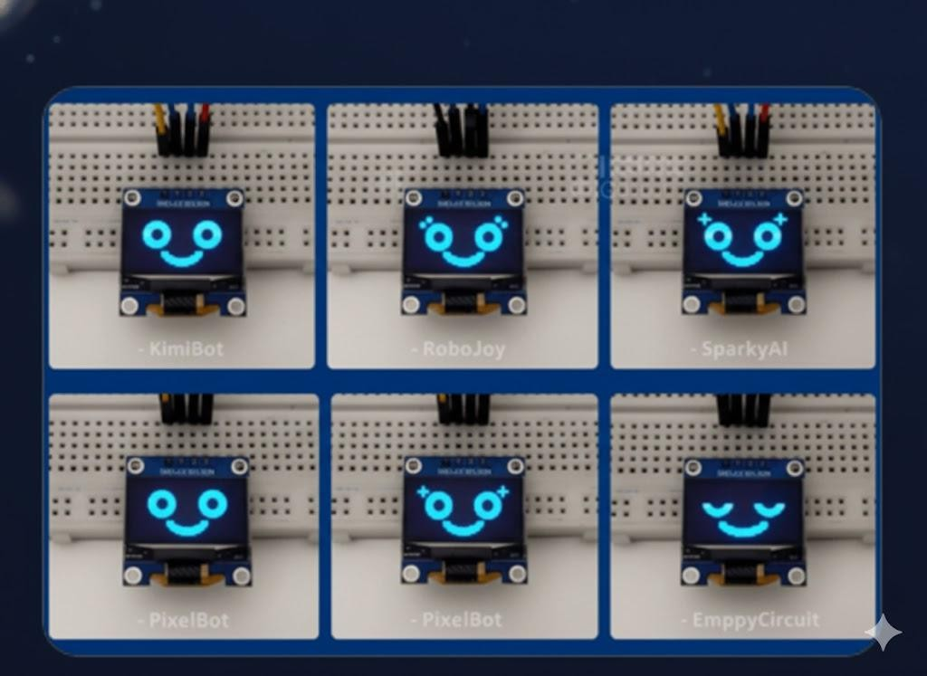
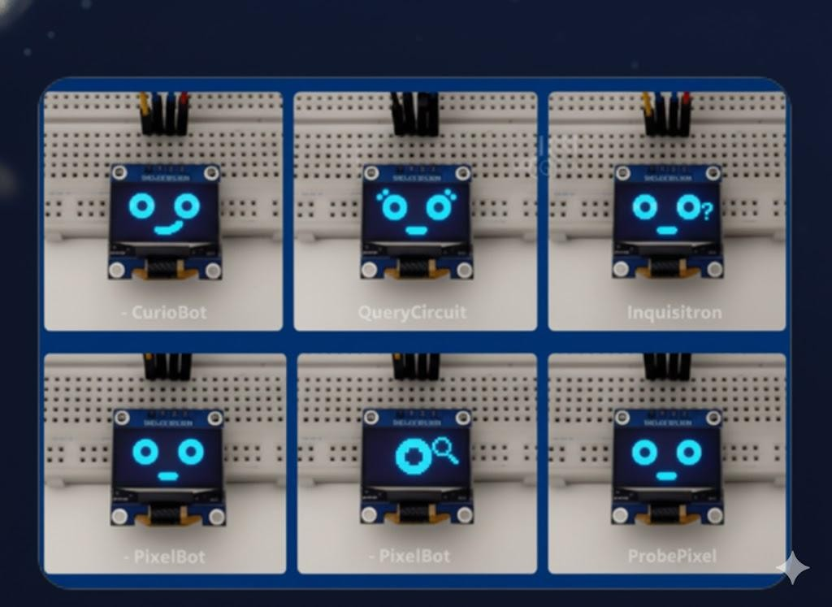


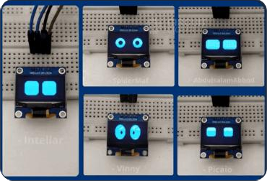
An Emotive Interface
Happy
Curious
Sleeping

Slide 21
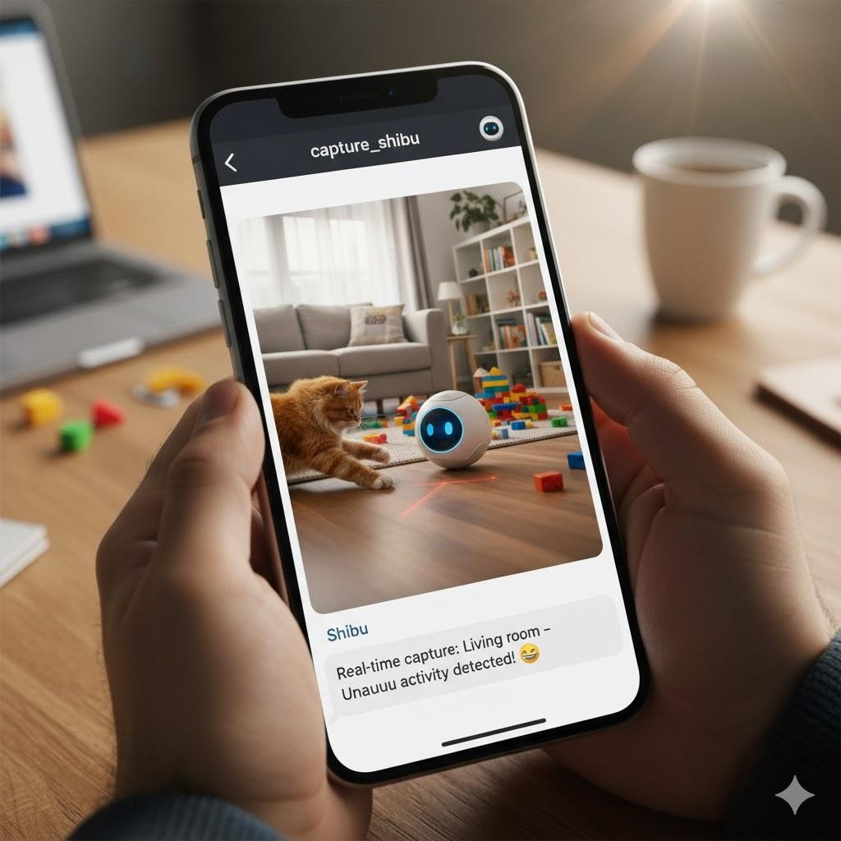
IoT & Remote Access
Connected Anywhere
Shibu integrates with Telegram to double as a home
surveillance unit.
Remote Command: Send text commands from
anywhere.
Live Updates: Request photos or status reports.
Security: Receive motion alerts to your phone.

Slide 22






Power Management
Source
Logic Power
Motor Power
Li-ion Battery Pack
5V/5A Regulation
12V Direct Line

Slide 23


Modular Software Design
Core Intelligence
LLM Engine: Reasoning & Text Gen.
Vision Module: Camera & OpenCV.
Control & IO
Command Parser: Intent Classification.
Motor Control: Serial Communication.
Telegram Assistant: Cloud Bridge.

Slide 24
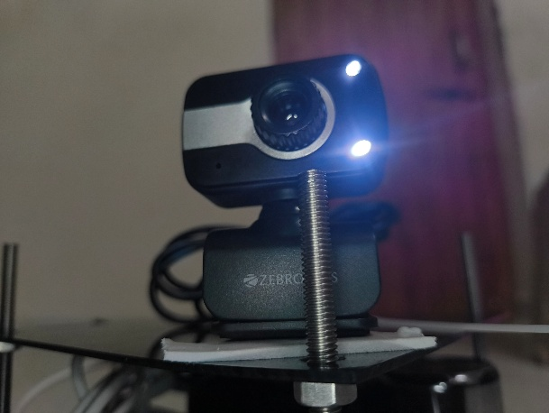
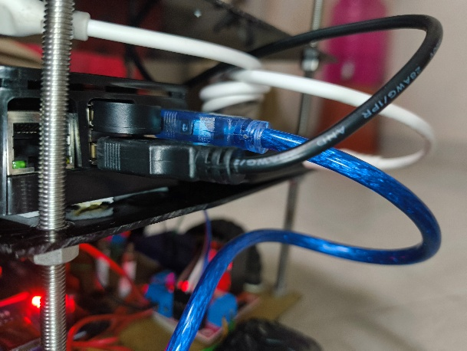
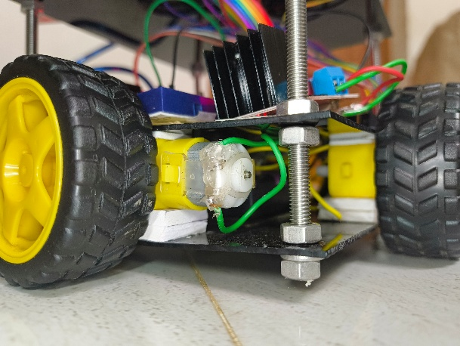
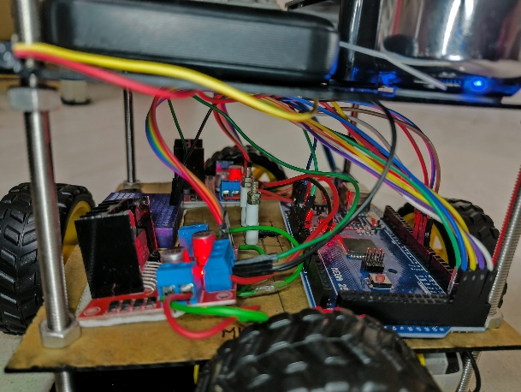
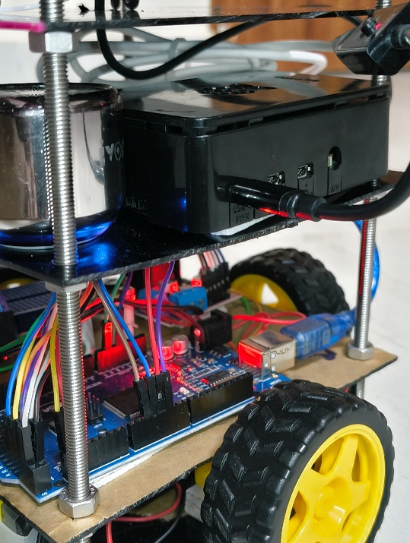
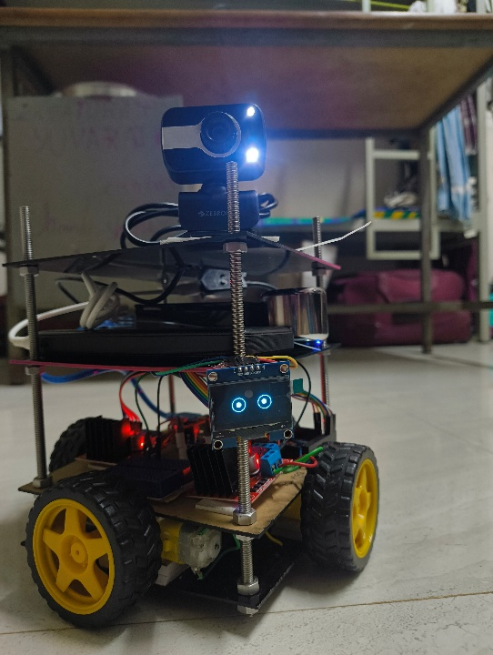

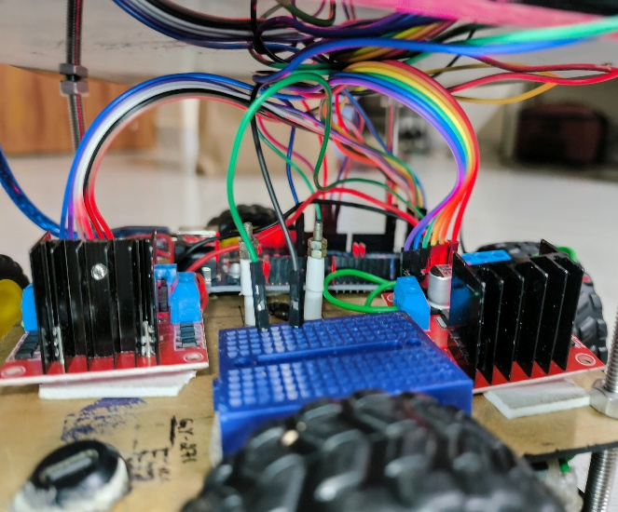
PROJECT SNAPSHOTS

Slide 25
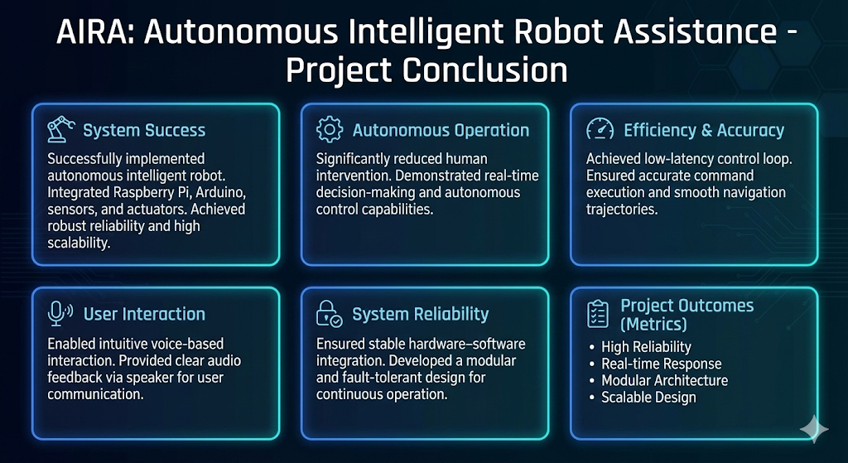
CONCLUSION

Slide 26
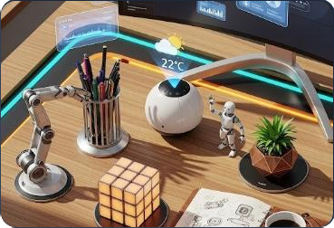
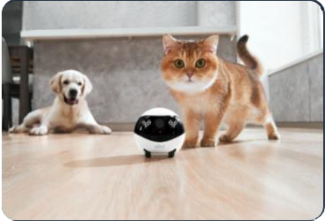
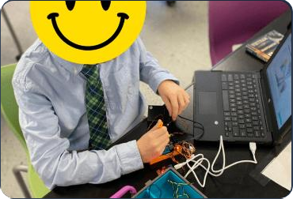
Use Cases
Home Assistant
Pet Companion
STEM Education

Slide 27
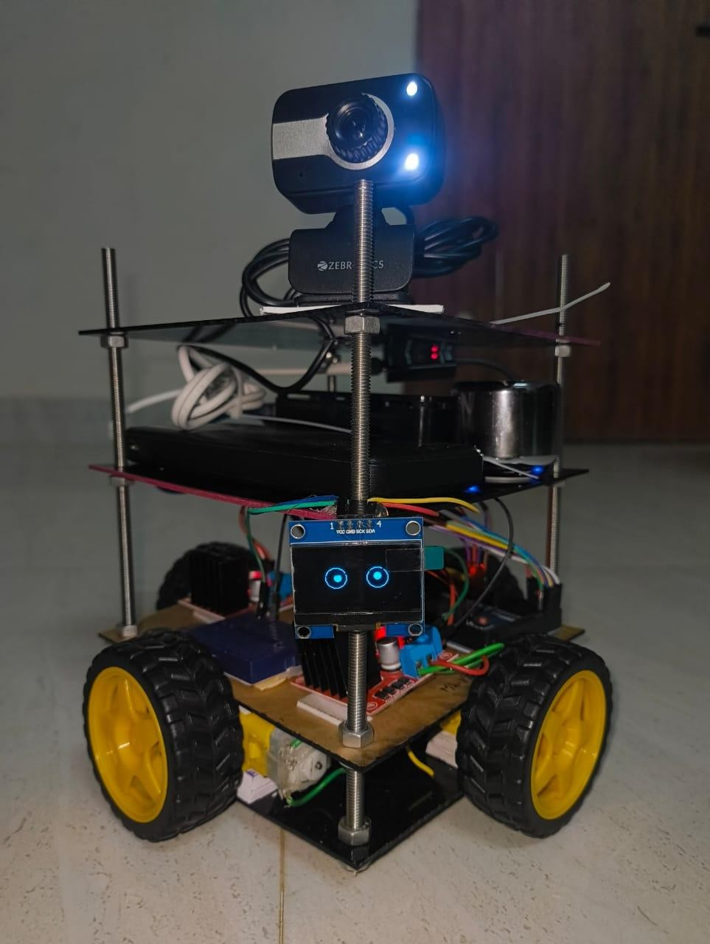
Shibu v2.0: The Future
Next Generation Features
We are already engineering the next evolution of personal robotics.
Upgrades include SLAM for autonomous mapping, active human following, Edge TPU integration for faster vision, and a sleek new spherical form factor.

Slide 28
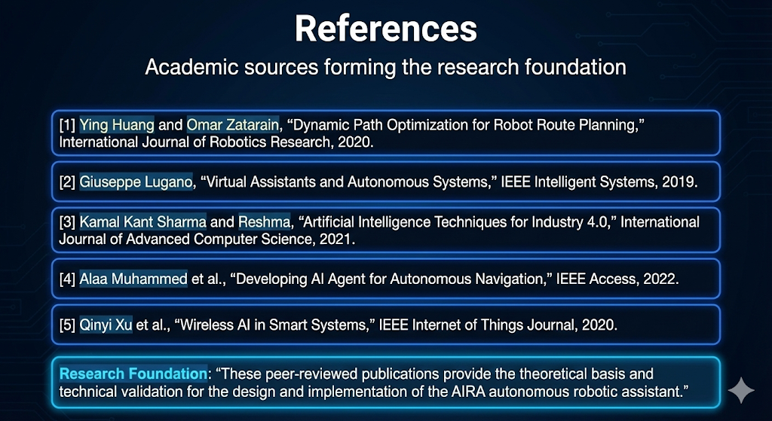

Slide 29
